Slide 1
Organic Customer Model Austin Shelton

Slide 2
Objective & Purpose
The objective of this project was to develop a model to predict which organic firms are most likely to become customers.
After doing so, we can create a custom campaign targeting our most promising organic leads.
The importance of using organic firms only as input to train the model is to eliminate bias arising from our past contacts with firms.
In addition, this model could be fully extendable to non-organic firms.

Slide 3
Data & Cleansing Process
Sample of 20,320 organic customers (LMS variables, scores, and inquiries)
Sample of 497,879 organic non-customers
Score levels and lagged changes up to the time of sale were calculated for Paydex, SER, FSS, and Delinquency Predictor scores
‘years_in_existence’ was calculated as 2014 – year(company start date)
Other dates were dropped so that the model won’t have inconsistencies going forward
Variables which only had ‘NA’ values were dropped
Variables which showed no variation were dropped as they add 0 predictive power to the model and are potentially dangerous to include

Slide 4
Data & Cleansing Process
There are four variable types in our data: “Numeric”, “character”, “integer”, and “factor”.
Factor variables with over 100 levels were dropped. This was done because variables which are factors and have many levels are almost always very non-informative in this dataset (things like a CEOs middle name, for example). Also, due to computational constraints they cannot be handled by many statistical methods (and would lilkely be insignificant anyway). This only dropped nine variables- primarily names of firm members and contacts.
In order to use our model of choice, all variables had to be coerced to a “factor” type. Thus, continuous variables had to be discretized.

Slide 5
Discretization of Non-factor Data
Non-factor data, such as “Sales” had to be coerced to a factor and put into bins.
For the model of choice (Naïve Bayes) the probability that a firm will be a customer, is calculated for each variable by bin, so it is important to assign non-categorical data to bins in a smart manner. Simply doing so based off crude cutoffs across all variables can greatly harm the performance of the model.
Step 1: Thus, I assume that all non-factor variables follow a normal distribution (a lot actually do, and a few, of course, do not- most things roughly do in large samples).
Step 2: Then I take the inverse normal cumulative distribution function (cdf) of each non-factor variable. This will be a number between 0 and 1 for each observation, and represents the percentage of population values smaller than the variable value; assuming that the variable actually follows a normal distribution.
Finally, the non-factor variable observations are ‘categorized’ or ‘factorized’ into decile bins by their inverse normal cdf. For a particular variable, assume a particular observation has an inverse normal cdf of .25. Then it is assigned to bin ‘3’ as it is in 20-30^{th%} of values for that variable (assuming normality). These bin values are factors and replace the previously numeric data.
Important: Even when the normality assumption is broken badly, this binning method preserves rank or ordinality, which is what is most important.

Slide 6
Final Dataset
Finally, a small handful of variables that were not eliminated by the prior constraints (5-10) just do not make any sense to keep (CEO or contact names, street address, fax #, etc.). These were dropped as well as the 50 or so lagged Paydex values included LMS.
Q: Why drop historical Paydex values??
A: Look-ahead bias. These include Paydex values after the point at which a firm purchases our product as well as before and these values are not standardized relative to a firm’s purchase date. Properly calculated Paydex, ser, fss, and dp scores at and prior to the time of sale are already included in the model.
This leaves us with a dataset with 502,225 observations and 223 variables.

Slide 7
Model Creation: Overcoming NA data
The biggest problem in our data for statistical modelling : ‘NA’ values. 43.8% of our overall data is ‘NA’. Obviously, for some variables the percentage of ‘NA’ observations is much higher (many variables have around 96% ‘NA’ data).
It’s not that we just have a few NA values for some variables as may be found in finance, ecology, etc. If this were the case variables could just be imputed by (1) taking the column mean (2) interpolation (if a time-series) (3) regressing on other variables (4) multiple imputation, etc.
The problem…. All these methods are designed to work well only if the data is (1) “Missing Completely at random” or at least “Missing at Random” (doubtful in most cases… especially ours) and (2) the majority (hopefully even the vast majority) of data is not missing. We could still impute data, but we need to realize that we are doing so would be horribly inaccurate and inconsistent.
Listwise deletion of all ‘NA’ data adds all sorts of biases to our model if data is not Missing at Random (biasing the model toward firms with more data collected- probably bigger firms), and also would reduce our sample size drastically– meaning our model could not be fairly applied to all firms in our data for predictive purposes.

Slide 8
Solution for ‘NA’ data
Multiple imputation by mean-matching would be the only plausible imputation strategy on our dataset but is very, very computationally expensive (requires a regression of every single variable on every other variable, random number generation, and large array allocations) and is still not reliable with our volume of ‘NA’ values.
Listwise deletion isn’t a great solution here. We could selectively identify variables we want to use if we knew what variables really matter- but we don’t. Also, we want to include all variables possible in this analysis, and create a model which can classify any firm in our data.
The only other solution is to choose a classification method that is designed to handle a large volume of missing data.
So, a natural choice was a Naïve Bayesian model.

Slide 9
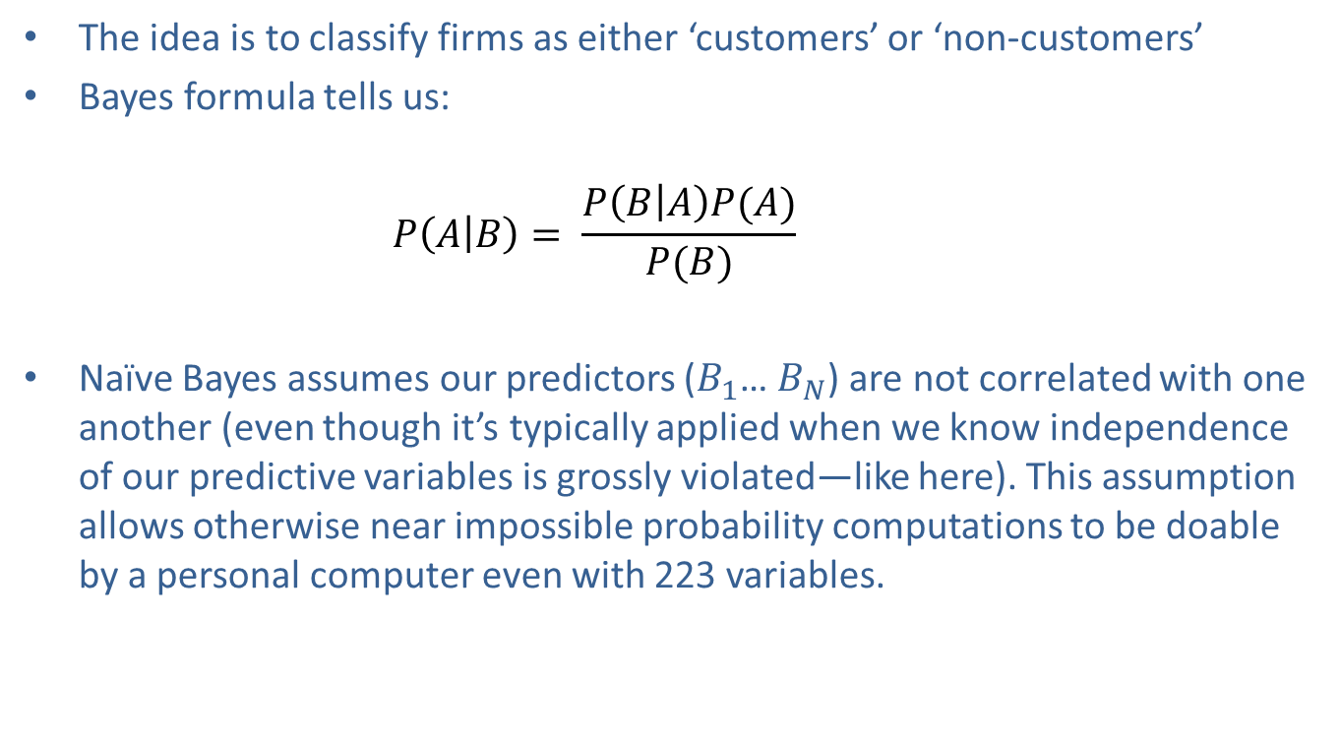
Naïve Bayes
The idea is to classify firms as either ‘customers’ or ‘non-customers’
Bayes formula tells us:
$$P\left(A | B\right)= \frac{P\left(B | A\right)P(A)}{P(B)}$$
Naïve Bayes assumes our predictors ($B_{1}$… $B_{N}$) are not correlated with one another (even though it’s typically applied when we know independence of our predictive variables is grossly violated—like here). This assumption allows otherwise near impossible probability computations to be doable by a personal computer even with 223 variables.

Slide 10
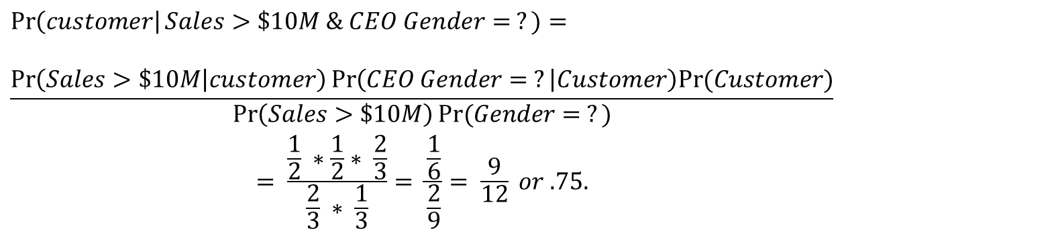
Bayes’ Basic Example
-Let’s say we want to classify customers. This made up data is below:
-Now, we want to classify ‘firm 4’ as either a customer or non-customer. This can be a little trickier than it looks:
Firm | Sales | CEO Gender | Customer
1 | >$10M | M | Yes
2 | $5-$10M | ? | Yes
3 | >$10M | F | No
Firm | Sales | CEO Gender | Customer
4 | >$10M | ? | ?
$$\operatorname{Pr}\left(customer\right|Sales>\$10M \& CEO Gender= ?)=$$
$$\frac{\operatorname{Pr}\left(Sales>\$10M | customer\right)\operatorname{Pr}\left(CEO Gender= ? | Customer\right)Pr⁡(Customer)}{\begin{aligned}\operatorname{Pr}\left(Sales>\$10M\right)Pr⁡(Gender= ?) \\ = \frac{\frac{1}{2} ∗\frac{1}{2}∗ \frac{2}{3}}{\frac{2}{3} ∗ \frac{1}{3}}= \frac{\frac{1}{6}}{\frac{2}{9}}= \frac{9}{12} or .75.\end{aligned}}$$

Slide 11
Organic Customer Model: Bootstrapped Naïve Bayes Ensemble
Our model is a Naïve Bayes’ Model on our 222 predictors and our target variable, customer status.
However, there are some issues to resolve still. How was NA data handled?
Naïve Bayes allows for NA or missing data! It is just integrated out. In other words, when the algorithm encounters a row in our training set with NA values, the variables which are ‘NA’ just fall out of the probability estimation; and only the available information is used to compute a conditional probability for each firm. It’s that simple.

Slide 12
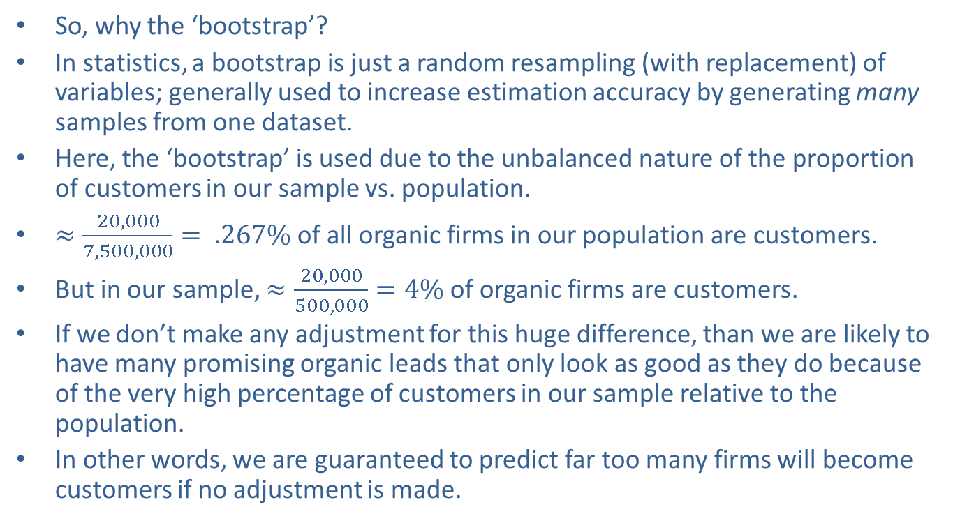
Organic Customer Model: The ‘Bootstrap’ Part
So, why the ‘bootstrap’?
In statistics, a bootstrap is just a random resampling (with replacement) of variables; generally used to increase estimation accuracy by generating many samples from one dataset.
Here, the ‘bootstrap’ is used due to the unbalanced nature of the proportion of customers in our sample vs. population.
$≈\frac{20,000}{7,500,000}= .267\%$ of all organic firms in our population are customers.
But in our sample, $≈\frac{20,000}{500,000}=4\%$ of organic firms are customers.
If we don’t make any adjustment for this huge difference, than we are likely to have many promising organic leads that only look as good as they do because of the very high percentage of customers in our sample relative to the population.
In other words, we are guaranteed to predict far too many firms will become customers if no adjustment is made.

Slide 13
Organic Customer Model: The ‘Bootstrap’ Part
The solution to this problem is not obvious-in fact, it’s still an issue of academic research.
Here are some of the solutions offered:
We could randomly throw out customers in our data until .267% of firms in our sample are customers. I don’t like this solution at all as we lose information (and neither do most experts).
We could do nothing. This would mean we simply show way more ‘promising organic leads’ than there really are, and only a small portion of a campaign based on this model is actually a promising target audience. The good news is we would mail almost everyone who is possibly a good lead. The bad news is we would mail many, many firms who have no real promise. This is not great modelling; but it not be that bad for our particular business model (low acquisition cost, high acquisition value).
We could give up. Not a good solution, nor good for my job security.
Finally, we could bootstrap our data to create N datasets in which the percentage of customers is .267%, and, for each dataset, customers are randomly picked from the full population customers. Then we can run our model on all N datasets and in some manner average the results. I like this solution, as it is the most accurate and doesn’t just throw away ‘good data’.

Slide 14
Organic Customer Model: The ‘Ensemble’ Part
Because, we are now creating N simulated datasets from real data, we will have N Naïve Bayesian models, and N predictions for each firm we score as a potential target.
Thus, these N models form an ‘ensemble’, which describes our entire model.
I will set N to 100. Firms need a unanimous decision (100 votes) of ‘customer’ classification in order to be classified as a ‘customer’. We can lower this threshold as desired. In matters little as of now, as the votes from almost all our models agree (due to the large sample size of each bootstrapped dataset).

Slide 15
Model Results on Simulated Test Data
Keep in mind, only .267% of the firms are actually customers in our 100 bootstrapped datasets.
Given the amount of NA data and the very low probability of a firm becoming an organic customer, successful classification of organic customers is naturally very tough.
But, the model still does relatively well out-of-sample on the test dataset.

Slide 16
Model Results
 | Testing Data Performance: Predicted vs. Actual
 |  | Predicted
 |  | Customer | Non-customer
Actual | Customer | 240 | 162
 | Non-customer | 4,736 | 145,469
Takeaway:
We were correct in identifying 4.82% of customers as customers, versus .267% of customers we could pick by chance without a model. Although not a high raw number, this is a massive 1,700% boost in accuracy.
We were correct in identifying 99.9% of non-customers as non-customers. Basically, we can almost always tell when someone shows ‘no hope’ of conversion. This is useful.
We identified 59.70% of the total customers in the testing population, by only identifying 3% of the population as customers.
Overall, 96.75% of firms were correctly identified.
By changing the bootstrapping method and number of votes need to be classified as a customer, we can increase/decrease our Type I/II Error, to more/less selectively pick customers.

Slide 17

Top 25 Most Important Variables: Measures of Liquidity
$$R^{2}$$
Variable Name |  | Relationship
NET SALES | 0.26 | +
inq_365_count | 0.21 | +
TOTAL ASSETS (PRIOR STMT) | 0.21 | +
GROSS PROFIT | 0.21 | +
ACCOUNTS RECEIVABLE | 0.20 | +
ACCOUNTS PAYABLE | 0.20 | +
TOTAL CURRENT LIABILITIES | 0.17 | +
PRIOR NET WORTH (CASE STMT) | 0.17 | +
TOTAL CURRENT ASSETS | 0.16 | +
NET PROFIT | 0.16 | +
OTHER CURRENT LIABILITIES | 0.15 | +
LOCATION INDICATOR | 0.14 | +
TOTAL ASSETS | 0.13 | +
TOTAL LIABILITIES | 0.13 | +
MOST RECENT REPORT TYPE | 0.10 | -
NET WORTH (CASE STMT) | 0.09 | +
inq_90_count | 0.08 | +
COLLECTION PERIOD | 0.08 | +
FIXED ASSETS | 0.07 | +
CREDIT RATING | 0.07 | +
D&B RATING | 0.06 | +
WORKING CAPITAL | 0.06 | +
OTHER CURRENT ASSETS | 0.06 | +
ACCNTS PAYABLE TO SALES RATIO | 0.06 | +

Slide 18
Conclusion
The Organic Customer Model successfully identifies customers around 4.8% of the time in simulations from actual data, versus .267% we could achieve without a model. On the one hand, simulated test results should always be taken as better than we should expect for a test campaign, but on the other these customers were never actually mailed to indicating there may a significant opportunity for conversion of organic leads picked by the model.
A test campaign on around 20,000 or so of the 7,500,000 organic customers can effectively prove/disprove the real value of the model.
There are around 250,000 ‘promising organic firms’ the model can identify. Even converting 1% of these vs. the ~5% our model shows in theory, would be 2,500 new customers. At an average annual subscription of $1,500; this would be a $3,750,000 boost to sales. Converting anywhere near 5%, would obviously be a large revenue boost ($18.75 M at 5%).
If successful, there is nothing that limits the model from being extended- with a little extra effort- to all customers.
(With a lot of work) The reasons for why (high sales, inquires…etc.??) each firm is classified as a ‘customer’ or ‘non-customer’ can later be extracted in a rough manner from the predictions if necessary. This might be helpful in providing agents when supplying leads.

